Slide 1

Diamond State Port Corporation
Presentation to Joint Bond Bill Committee
April 26, 2004

Slide 2
What we will cover:
    Port’s importance to Delaware
    Business growth opportunities
    Requests for FY 2005

Slide 3
State Support: FY 1996-2004
$105 million granted under various Bond Bill appropriations created:
  Dedicated automobile handling berth
  New state-of-the-art refrigerated and chilled storage facilities
  Dry cargo storage facilities
  New container crane

Slide 4
Economic Impact: FY 1996-2004
Port cargo (fruits, meat, automobiles, juices, dry bulk) generated:
  31,600 direct and induced jobs (person-years)
  $182 million in local & state taxes
  $1.9 billion in personal income
  $1.7 billion in business spin-off

Slide 5
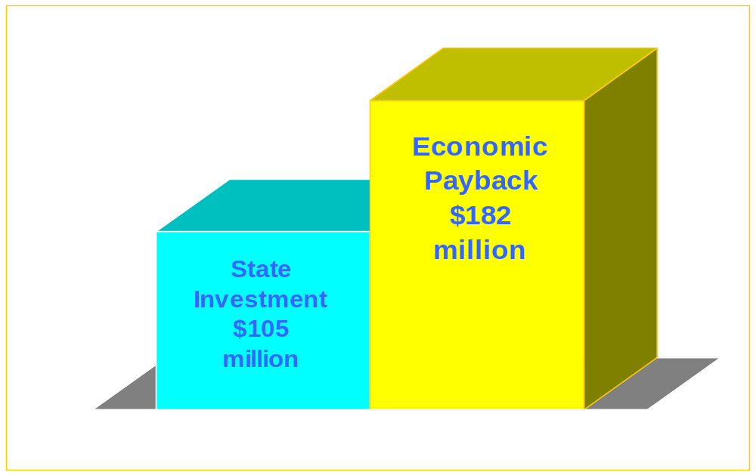
Economic Impact far greater than State Support
( $ millions)

Slide 6


Port = Jobs

Slide 7
Recent Business Achievements
5-year contract with Volkswagen
20-year renewal of Citrosuco agreement
5-year contract with Chiquita
5-year contract with Premier Juice
Capture of 100% of Australian meat import
Best ever Chilean fruit import season in 2004

Slide 8
Business Growth Opportunities
Potential for export of chicken products to Haiti
Expansion of current banana and other fruit import businesses
New multi-year newsprint handling contract
Import of forest products from South America
Import of dairy products from the Far East
New petroleum handling berth
Additional automobile import business

Slide 9
REQUESTS for FY 2005
$15 million from Bond Bill
Reprogram unused $692,000 from FY 2002 Bond Bill funded project
$4 million financial participation request pending with DRBA

Slide 10
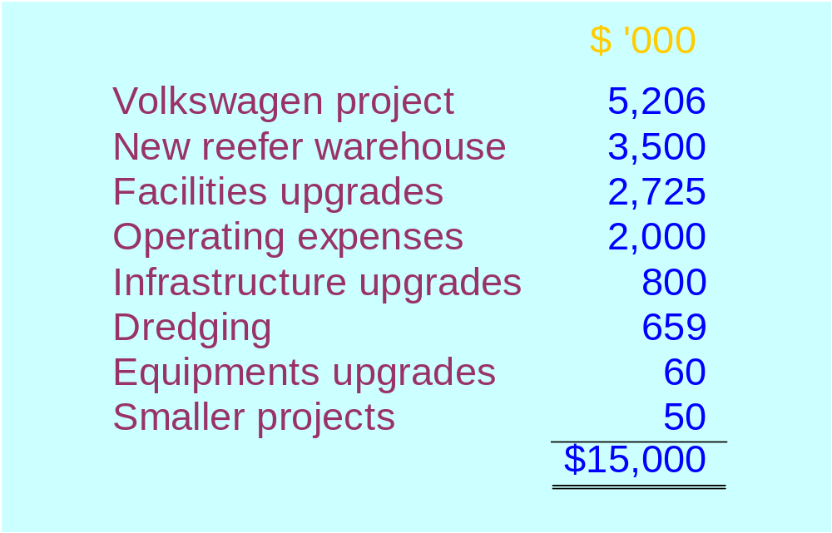
Request for FY 2005

Slide 11
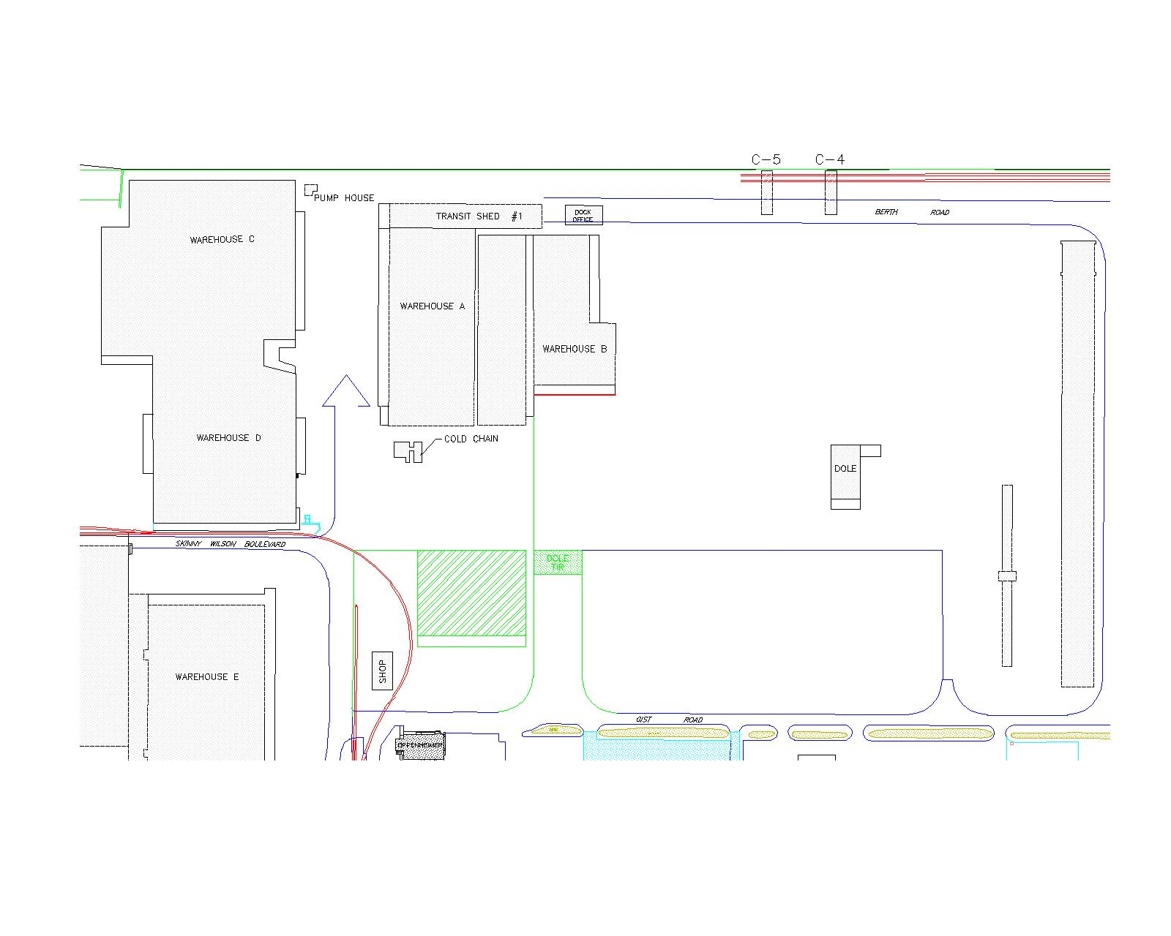
New reefer warehouse
Request for $4 million pending with DRBA

Slide 12
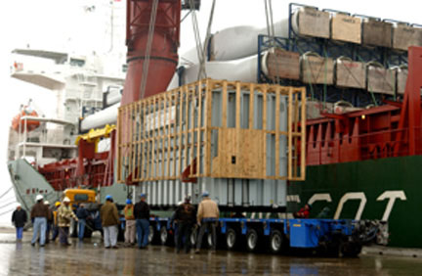
..onward to Sussex!

Slide 13
Thank you!

